Slide 1
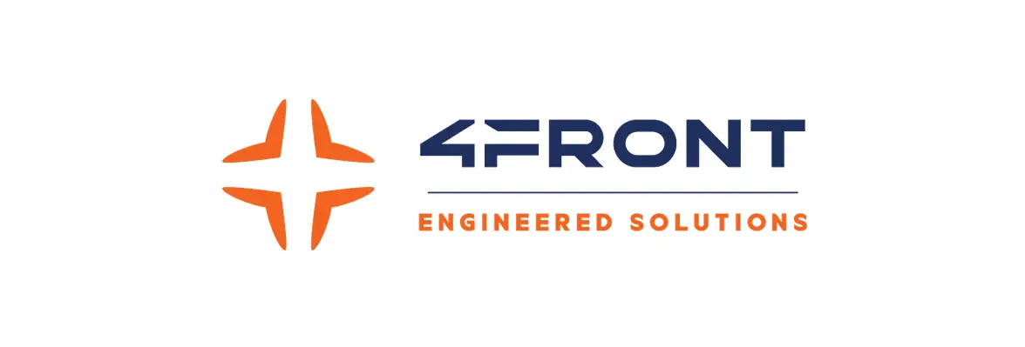
“The manufacturing sector is becoming increasingly data driven. Our digital transformation initiatives have enabled us to provide a better experience for our customers and staff members. We can respond to customers more quickly, retrieving relevant documents in seconds while speaking to them.”
Customer: 4Front Engineered Solutions
Industry: Manufacturing
Size: 500-1,000 employees
Country: U.S., Canada, Mexico
Products and Services:
Intelligent Data Capture
Process Automation
Document and Records Management
— Amy Skoug, Director of IT - Applications, 4Front
As a manufacturer of loading dock equipment, 4Front Engineered Solutions needed a way to centralize information and automate processes such as order management and accounts payable.
4Front implemented Laserfiche to digitize and automate order cycle documentation and business processes.
In addition to reducing reliance on manual processes, 4Front used Laserfiche to create a digital-first, streamlined employee experience when interacting with order cycle management, and accounting functions. This has helped to increase productivity, transparency, and accountability overall.

