Slide 1
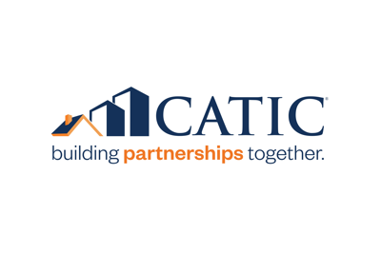
“With new Laserfiche processes, as more work comes in the door, we now have the ability to increase throughput. And the whole industry has moved toward focusing on profitability per unit. So, we’re able to also facilitate growth without having to hire more staff. We are also able to improve processes without eliminating staff.”
Customer: CATIC
Industry: Financial Services
Size: 250 employees
Country: United States
Products and Services:
Document and Records Management
Information Governance
Integrations
Intelligent Data Capture
Process Automation
— Chris Cooper, Senior Operations Analyst, CATIC
CATIC previously relied on manual, paper-heavy processes. A legacy document management system did not provide the modern intelligent capture, process automation and integration capabilities the organization needed to optimize operations.
CATIC migrated content from the legacy document management system into Laserfiche and began to automate processes including in its CATICTrac service, records management, claims and compliance.
CATIC’s Laserfiche initiatives have saved over $325,000 annually and created up to 90% more efficiency in some processes. Automating processes has increased capacity without creating the need to hire more staff, and reclaimed time for employees to spend on value-added activities.

