Slide 1
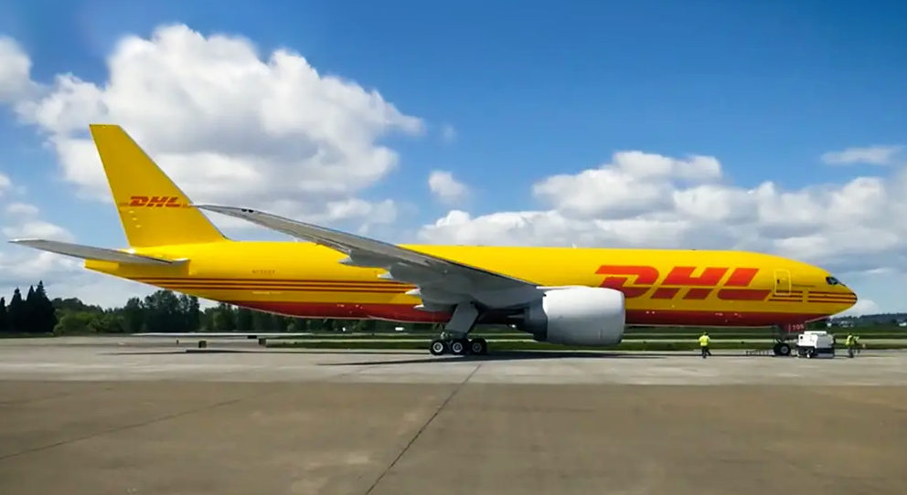
“Laserfiche is so easy. You can build a process in your mind, put it on paper, and Laserfiche will do its magic.”
— Rodolfo Gonzalez, Information Technology Manager, DHL de Guatemala S.A.
Customer: DHL Aviation
Industry: Logistics
Size: 1,000+ employees
Region: Latin America
Products and Services:
Document and Records Management
Intelligent Data Capture
Process Automation
As DHL strengthens infrastructure in Latin America, the IT department needed to build more automated, digital and sustainable operations. Initiatives to digitize flight information and records for pilots and dispatchers evolved into larger projects in airplane maintenance and legal.
Laserfiche was the perfect solution for its records management, electronic forms and process automation capabilities. As departments discover new efficiencies and see how easy Laserfiche is to use, the Laserfiche project list continues to grow.
With Laserfiche, DHL has created more sustainable and efficient operations. These digital initiatives have also opened up opportunities to gather data on processes, enabling the organization to continue to optimize and grow without sacrificing quality in its services.

