Slide 1
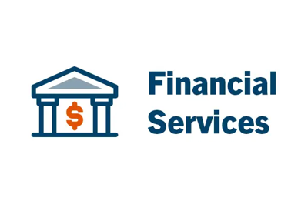
Size: $2 billion AUM
Region: North America
Products and Services:
Document and Records Management
Intelligent Data Capture
Integrations
Process Automation
New Account Opening in 30 Minutes
An investment advisory firm needed to expedite its new account opening process, which was traditionally dependent on paper forms and required staff to mail packets between various approvers and stakeholders, resulting in delays.
The firm used Laserfiche’s workflow tools to automate new account opening, integrating the system with DocuSign, Tamarac CRM and Laser App.
The digitization initiative has cut new account opening process time from one week down to a half hour. This success also led to a more simplified audit preparation process. The firm estimates that Laserfiche produces an annual time savings of over 40,000 hours.

