Slide 1
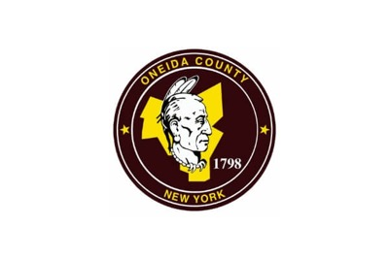
“Our use of technology has been a key factor in continuing operations, and enabling continuity of citizen services. We had been using Laserfiche in many different ways prior to this, and we were able to build on those solutions to develop new ones that fit our current needs.”
Customer: Oneida County, New York
Industry: Government
Size: 230,274 residents
Country: U.S.
Products and Services:
Intelligent Data Capture
Document and Records Management
Information Governance
Process Automation
— Anthony J. Picente Jr., County Executive, Oneida County
Oneida County needed quick solutions to support staff and citizens during COVID-19. These included immediate provisioning of devices needed to work from home, enabling access to systems remotely, monitoring and supporting residents with COVID-19, and outreach to local businesses.
The county was able to use its existing Laserfiche system to roll out electronic forms and automated workflows for staff to quickly collect necessary information and complete critical processes when time was of the essence.
The county enabled remote work using Laserfiche, while providing a way for the health department to reach out to people with COVID-19 and prevent further spread. The planning department leveraged Laserfiche to collect local business surveys, facilitating a better understanding of the pandemic’s impact on the local economy.

