Slide 1
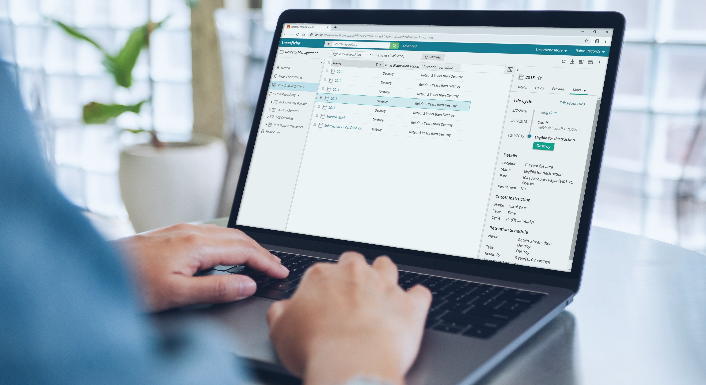

“Since implementing Laserfiche, we have greater insight into on-site locations with recurring problems. Staff can more effectively identify and address problems, saving on time and costs without revisiting the same location again.”
Customer:
Town of Paradise
Industry:
Government
Size:
Over 22,000 residents
Country:
Canada
Products and Services:
Document and Records Management
Intelligent Data Capture
Process Automation
— Elizabeth Piercey, Purchasing and Risk Manager, Town of Paradise
The Town of Paradise previously ran on processes that were dependent on the submission of physical documents. This led the town to seek a solution to digitize content and core processes as part of a wider digital transformation initiative to facilitate service to citizens and minimize storage costs.
Laserfiche was implemented initially to manage filing of civic documents, as well as to develop workflows and forms for processes such as accounts payable, building inspections and correspondence management.
The Town of Paradise has been able to accelerate its digital transformation, which was crucial during the pandemic as employees worked from home. Digitizing over 400,000 files since 2015, the town has also experienced increased efficiency in back-office tasks by 30%.

