Slide 1
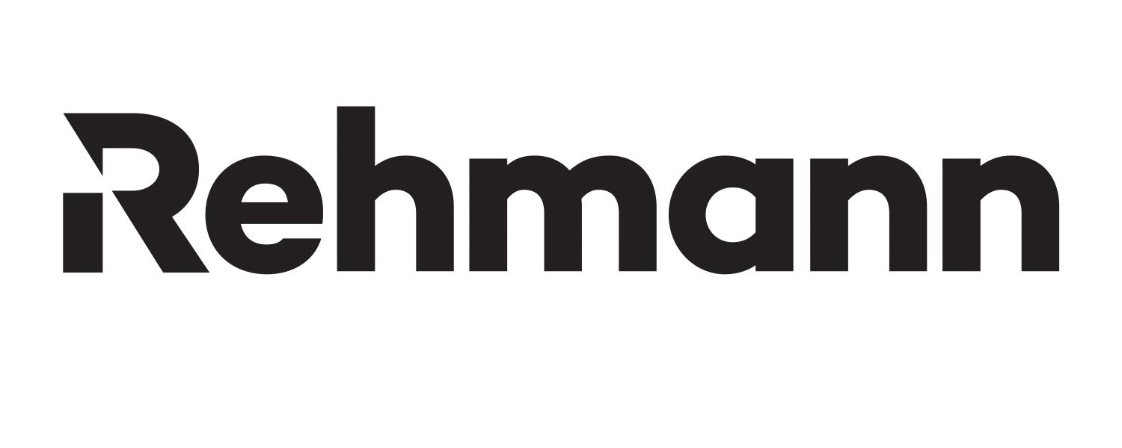
“Our work technology must keep up with the apps we use every day on our phones. The way we interact with technology in all aspects of our lives has changed, so it's critical for our office environment to keep up,” said Flourry. “Laserfiche makes it easy to design processes that our people really want to use.”
Customer: Rehmann
Industry: Wealth Management
Size: $3.42 billion in assets under advisement as of May 2023
Country: United States
Products and Services:
Document and Records Management
Information Governance
Integrations
Intelligent Data Capture
Process Automation
— Amy Flourry, Director of Operations, Rehmann Wealth
Rehmann’s wealth management practice needed to create consistency in workflows across offices in Michigan, Ohio and Florida, while maintaining compliance in a complex regulatory environment.
The firm used Laserfiche to create a consistent way to capture data, including client information during digital client onboarding, and build workflows and integrations that eliminated manual tasks and data entry that could potentially lead to human error.
Rehmann streamlined the new account opening process, enabling the firm to bring in 400 new accounts and $200 million in new assets in 2022. Rehmann’s records management and workflows greatly reduced the burden of compliance and audits on associates and opened the door to ongoing process innovation.

