Slide 1
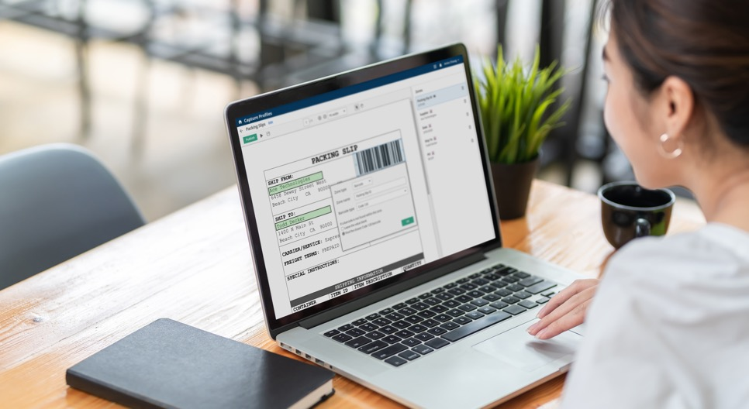
“Our demographic expects Amazon-type service. They want it right there, immediately, 24/7. Any truly public record is there [in Laserfiche] and accessible for people to find themselves.”
Customer: Tompkins County, New York
Industry: Government
Size: 105,740 residents
Country: U.S.
Products and Services:
Intelligent Data Capture
Document and Records Management
Information Governance
Process Automation
— Maureen Reynolds, Tompkins County Clerk
Initially, Tompkins County sought a means to help constituents more easily access public records without encountering red tape and long wait times. At the same time, the county was at capacity for paper records and preparing to construct a new building to store them.
Laserfiche was implemented in the county seat of Ithaca for its records management and digital workflow capabilities, supported by powerful compliance tools. With the initial success in Ithaca, other municipalities were quickly brought onto the system.
Beyond $5.5 million saved from not having to build a new records facility, the county created a transparent and easy to use records request solution. Records requests that once took 28 days are now completed in 12. The initiative has also strengthened information governance, data security and disaster recovery across the county.

